Slide 1

AI-SUPPORT SYSTEM
Group NO:3
SHEBIN T.R HGW23AD018
DEVANANDA A.M HGW23AD007
ARCHANA K.M HGW23AD004
AJAY K HGW23AD002
BATCH: 2023-2027, 6th SEMESTER
ARTIFICIAL INTELLIGENCE & DATA SCIENCE

Slide 2
Contents Page
Introduction
Literature Review
Proposed System
Software /Hardware Requirements

Slide 3
INTRODUCTION
Growth of digital platforms has increased the demand for automated support systems
Traditional support methods such as FAQs and rule-based chatbots are limited
Keyword-based systems fail to understand user intent accurately
Artificial Intelligence enables natural language interaction with users
Large Language Models generate fluent responses but may produce incorrect information
Retrieval-based approaches reduce hallucination by grounding answers in documents
The proposed General AI Support System uses semantic search for information retrieval
Accurate responses are generated using relevant document content
The system is domain-independent and adaptable to multiple applications
It reduces dependency on manual customer support

Slide 4
Literature review-1
Enhancing Bank Website Accessibility and User Experience through an AI-Driven Information Assistant
Author: A Avagyan, D Davtyan
Year Of Publication:2024
Problem Statement
Bank websites rely on keyword-based search systems that fail to understand user intent.
Users often receive irrelevant information and must navigate multiple pages to find answers.
Poor guidance and complex website structures increase user frustration and support requests.
Proposed Solution
The paper proposes BIRA, an AI-driven information assistant for bank websites.
BIRA uses Retrieval-Augmented Generation (RAG) to combine real website data with a language model.
Website content is processed using LangChain and stored as embeddings in ChromaDB.
The assistant provides instant, accurate, and context-aware responses, improving accessibility and user experience

Slide 5
Methodology
The system follows the Retrieval-Augmented Generation (RAG) framework to generate accurate responses.
Bank website content is collected using ethical web scraping methods.
Each webpage is converted into a structured document format.
These documents are transformed into vector embeddings.
The embeddings are stored in ChromaDB, which acts as a vector database.
LangChain is used to connect document retrieval with the language model.
A large language model generates answers using the retrieved information.
Results
The system successfully answers a wide range of banking-related queries.
The responses are accurate and relevant to user questions.
The use of real website data reduces incorrect or misleading answers.
The system improves user experience and reduces the workload on customer support.

Slide 6
Literature review-2
Systematic Analysis of Retrieval - Augmented Generation-Based LLMs for Medical Chatbot Applications
Author: Arunabh Bora and Heriberto Cuayáhuitl
Year Of Publication:2024
Problem Statement
Medical chatbots must give accurate and trustworthy answers.
Traditional large language models can produce incorrect or hallucinated medical information.
Fine-tuning alone does not always solve accuracy and reliability issues.
High computational cost limits real-world medical chatbot deployment.
Objective
To study how Retrieval-Augmented Generation (RAG) improves medical chatbot performance.
To compare base models, fine-tuned models, and RAG-based models.
To evaluate models in resource-constrained environments.

Slide 7
Methodology
Three open-source LLMs are evaluated: Flan-T5-Large, LLaMA-2-7B, and Mistral-7B.
Medical datasets such as MedMCQA and Meadow-MedQA are used.
Medical books and journals are stored in a vector database for RAG.
Models are tested under three settings:
Base model with RAG
Fine-tuned model without RAG
Fine-tuned model with RAG
Results
Fine-tuned models with RAG give the best accuracy.
RAG reduces hallucinations in medical answers.
Mistral-7B with RAG performs best overall.
Type-A MCQ evaluation performs better than Type-B.

Slide 8
Literature review-3
AI Chatbot using Retrieval-Augmented Generation with Custom Dataset Integration
Author: J Ahmad, MMK Mahin
Year Of Publication:2025
Problem Statement
Many students struggle to understand mathematical concepts and multi-step problem solving.
Traditional learning methods do not provide instant, personalized help.
Existing chatbots often fail to explain reasoning steps clearly.
Proposed System
The paper proposes an AI-based mathematical chatbot.
It uses Large Language Models (LLMs) to solve math problems step by step.
Retrieval-Augmented Generation (RAG) is used to support the model with relevant mathematical knowledge.
The system is built using Google Vertex AI Agent Builder and Dialogflow.

Slide 9
Methodology
Mathematical datasets such as GSM8K, Google DeepMind Math, and Bangla Math datasets are used.
RAG retrieves relevant examples or rules when needed during problem solving.
The chatbot provides explanations in English and Bangla.
Results
The chatbot successfully solves various mathematical problems.
Step-by-step explanations improve student understanding.
The system shows better accuracy and reasoning compared to basic chatbots.
It can be used as an effective learning support tool in education.

Slide 10
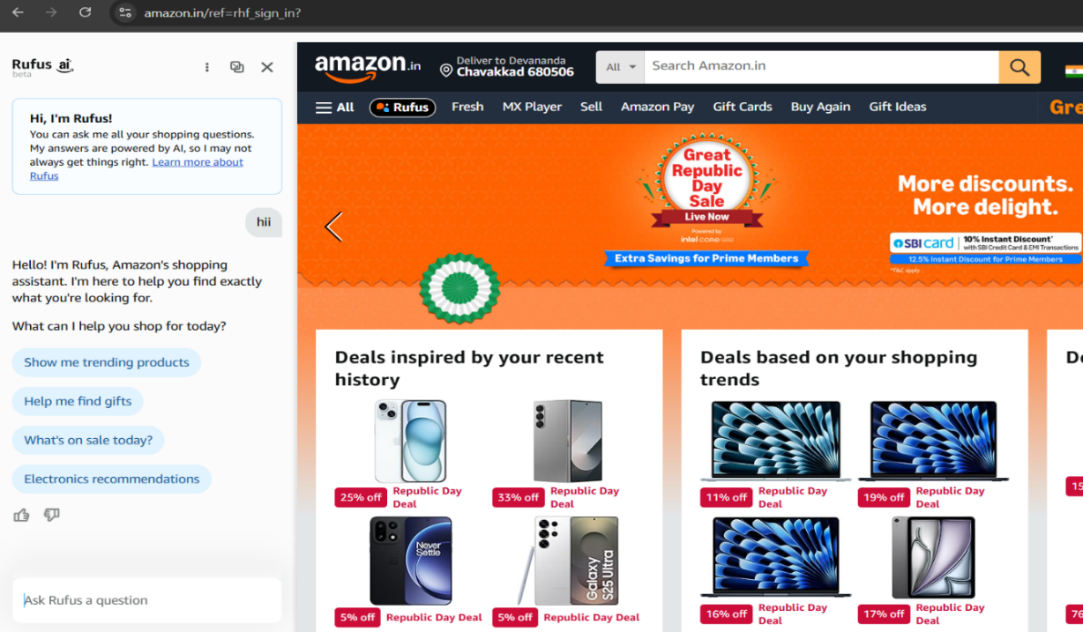
LITERATURE REVIEW – 4
Shopping Assistant Chatbot (Amazon – Rufus AI)
Rufus is an AI-powered shopping assistant that helps users with
product discovery, recommendations, and deals within the Amazon
platform
The chatbot is task-oriented and domain-specific,
focusing only on e-commerce-related interactions
User queries are handled using predefined intents and internal
product data rather than document-based semantic retrieval
This system highlights the limitation of task-specific chatbots
and motivates the need for a general, document-driven AI support system

Slide 11
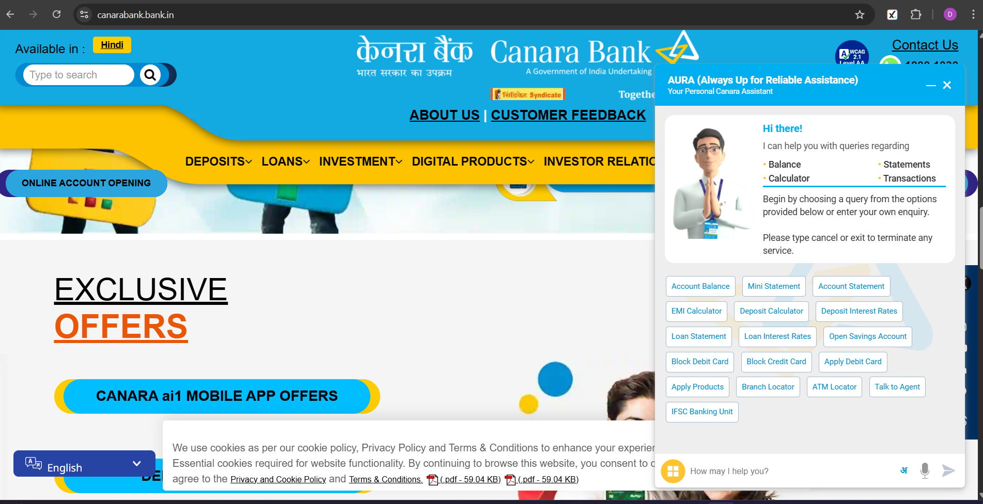
LITERATURE REVIEW – 5
Menu-Driven Banking Chatbot (Canara Bank – AURA Assistant)
allows users to interact through text-based chat for accessing banking services.
User queries are processed using basic natural language understanding and mapped to predefined intents.
Conversations follow a predefined and controlled flow to ensure accuracy and security.
The system effectively handles common banking requests, but has limitations with complex or open-ended queries.
The banking chatbot operates

Slide 12
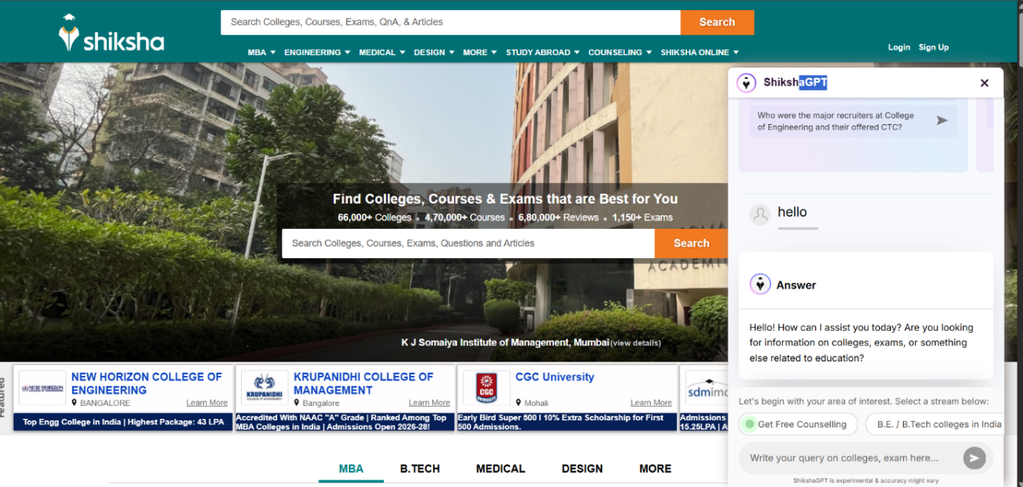
LITERATURE REVIEW – 6
Educational Support Chatbot (ShikshaGPT)
ShikshaGPT provides AI-based support for education-related queries such as admissions, fees, placements, and exams
The chatbot is domain-specific, focusing only on educational information and guidance
User queries are handled using LLMs
The system does not allow dynamic document upload or real-time knowledge expansion

Slide 13
Software/Hardware Requirements
Software Requirements
Python (Backend)
Flask (Frame work)
Cloud LLM – using API
Document Converter & Vector DB modules
HTML,CSS,JS frontend
Sentence embedding model
MongoDB (DataBase)
VS Code
Hardware Requirements:-
Desktop or Laptop
4gb RAM or more
Intel i5/AMD equivalent or more

Slide 14
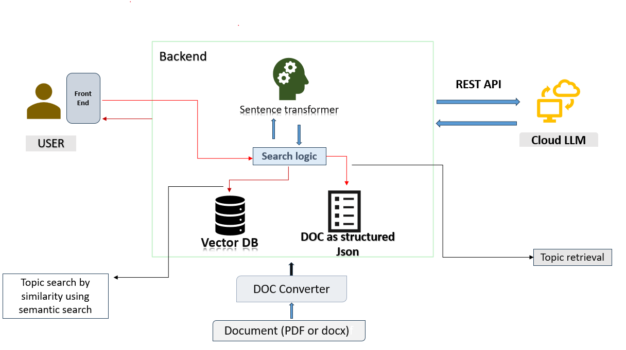
System Architecture

Slide 15
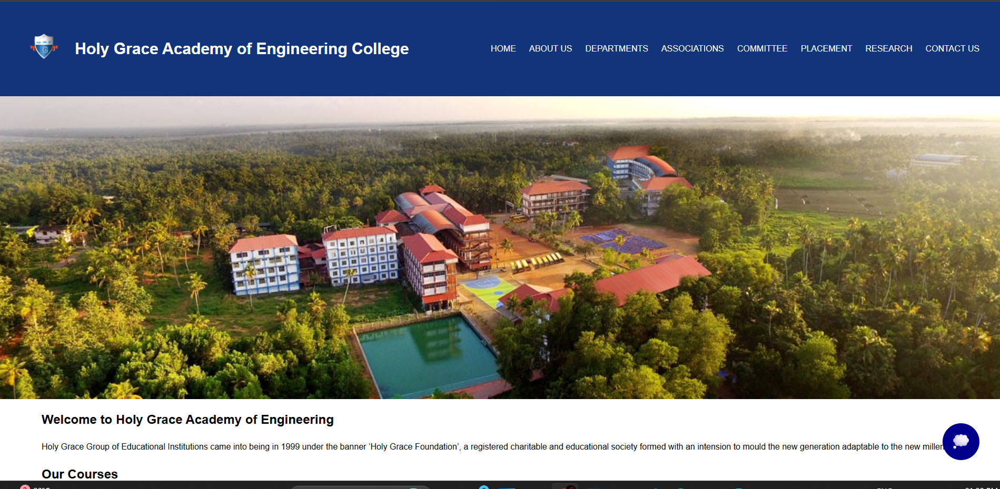
FINAL SYSTEM
Home Page

Slide 16
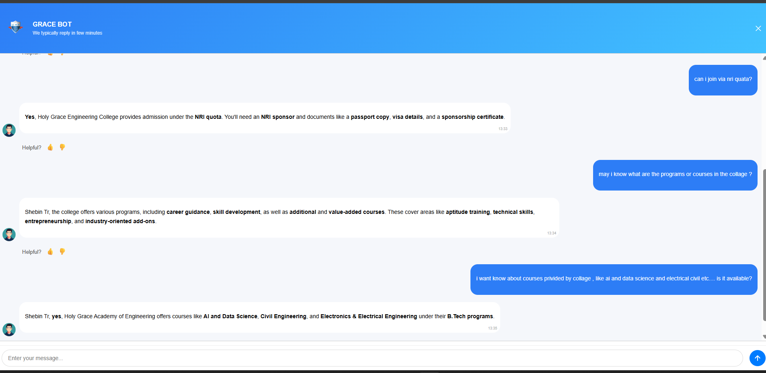
Chat Interface

Slide 17
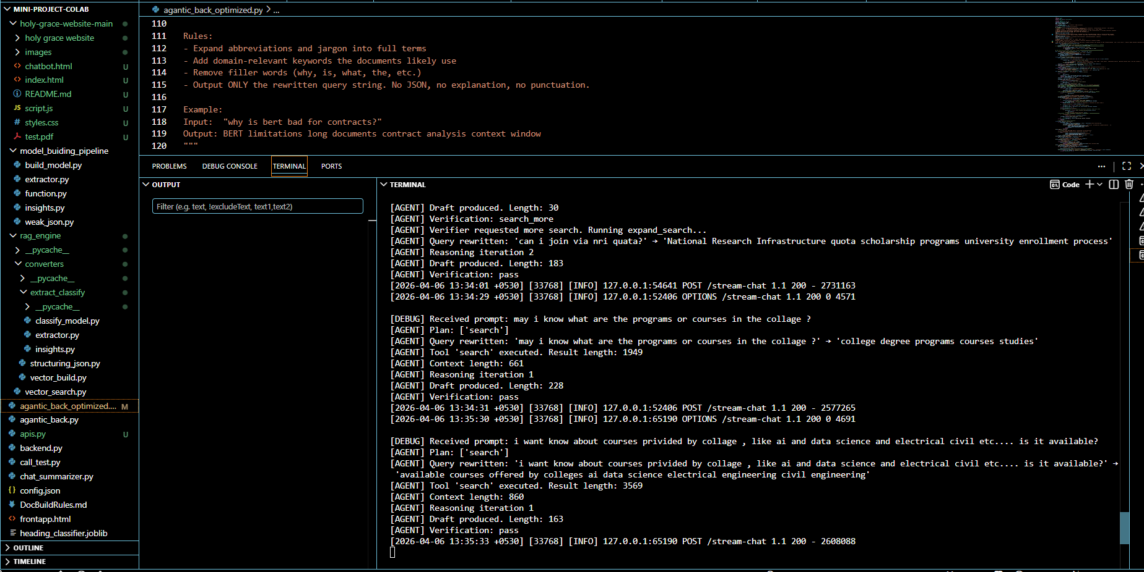
Backend Console Log

